Slide 1




GROUP 8
AMERICAN SIGN LANGUAGE RECOGNITION IN PYTHON USING DEEP LEARNING

Slide 2

OBJECTIIVE
ASL is the primary language for many deaf and hard-of-hearing individuals in America.
The project aims to help bridge the communication gap between the deaf and hearing communities
Notes:
the project is focused on training 2 deep learning model to recognize American Sign Language (ASL) gestures for 39 classes of signs. The dataset contains images of the 39 different signs, represented by numbers, letters, and some common phrases such as "I love you" and "Best of luck."
The goal of the project is to create 2 models that can accurately classify input images of ASL gestures into their respective classes. This can have practical applications in helping people who are deaf or hard of hearing communicate more effectively with those around them, as well as potentially enabling machines to interpret sign language.
The approach used in the project involves building a deep convolutional neural network (CNN) using the Keras library in Python. The CNN is trained on the provided dataset of ASL gesture images, and the resulting model is then evaluated on a separate test set to assess its accuracy.

Slide 3
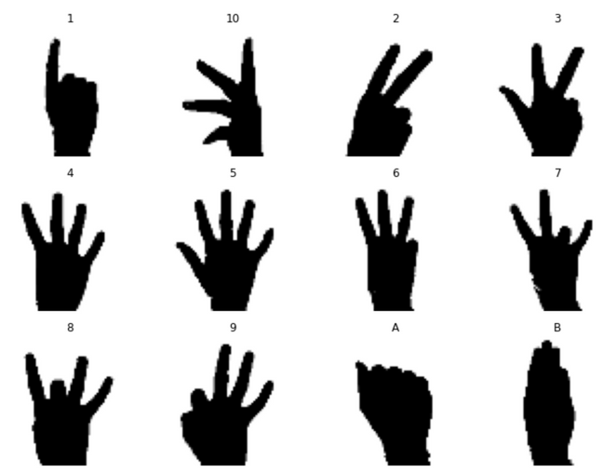
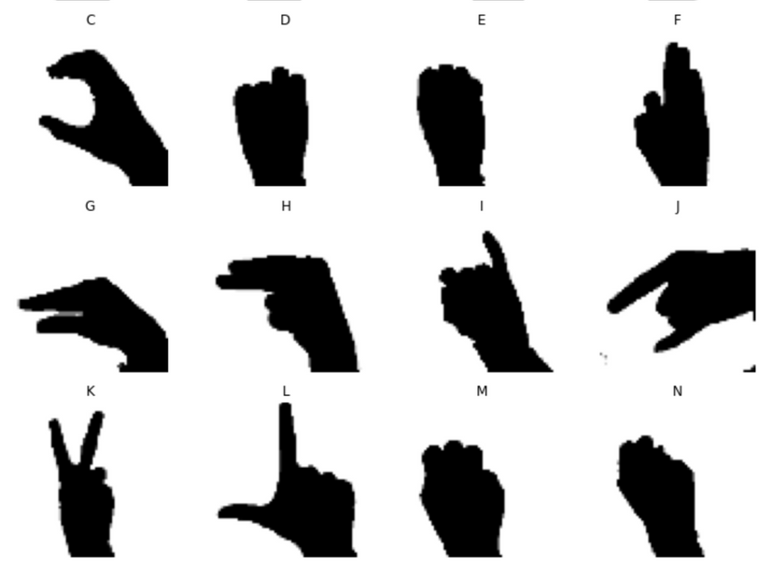
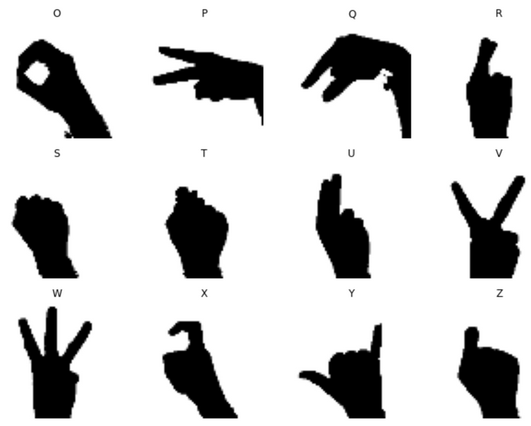
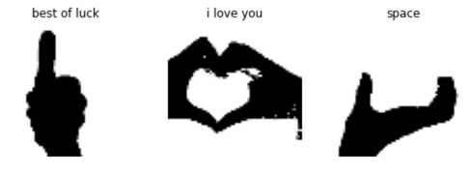
DATASET
Notes:
We have 2 folders : training & evaluation sets. The training set will be split into training and test sets. The evaluation set will be used later.

Slide 4
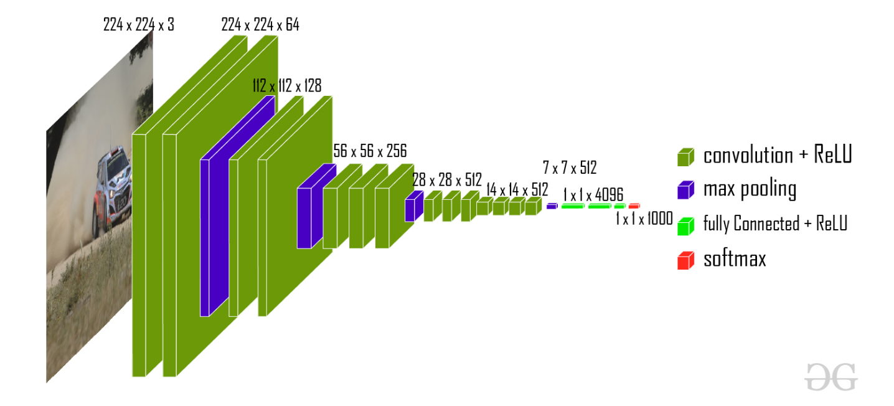
VGG16 ARCHITECTURE
Notes:
In this project, we've used 2 transfer learning models..VGG16 and resnet50.
VGG16 is a convolutional neural network architecture that was introduced by the Visual Geometry Group (VGG) at the University of Oxford in 2014. It consists of 16 convolutional layers and 3 fully connected layers, making it a deep neural network. VGG16 is known for its simplicity and uniformity in architecture, where each layer performs a 3x3 convolution operation with a stride of 1 and a padding of 1, followed by a ReLU activation function and a 2x2 max pooling operation with a stride of 2. VGG16 has achieved excellent performance on image classification tasks, particularly on the ImageNet dataset.

Slide 5
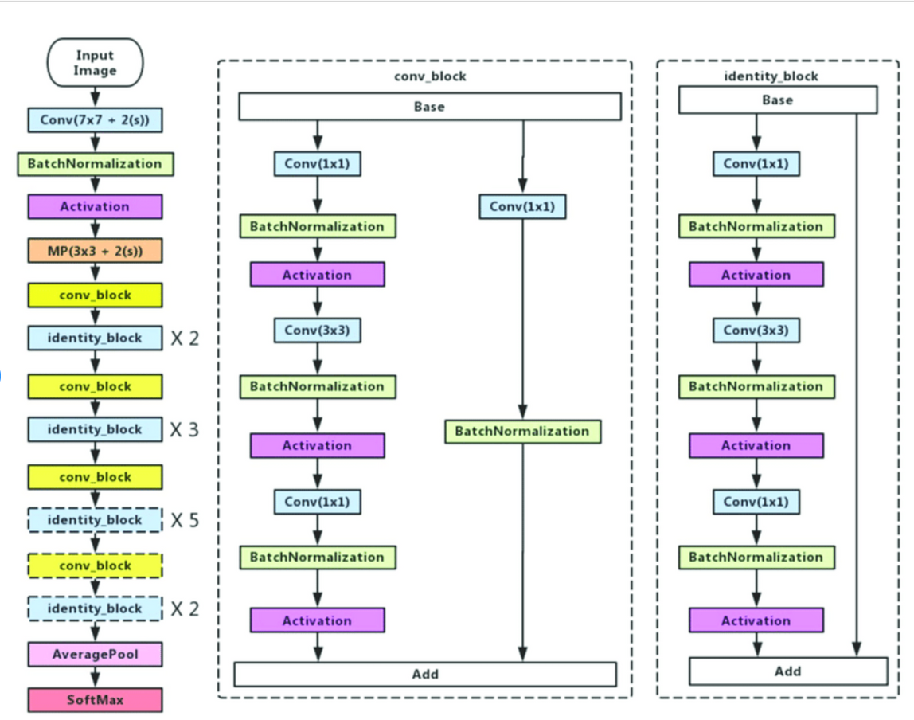
RESNET50 ARCHITECTURE
Notes:
ResNet50 is a neural network that's good at recognizing images. It's made up of 50 layers and uses special connections between some layers to help the network learn better. These connections are called residual connections and they make it easier for the network to learn deep representations of the input data. ResNet50 is particularly good at recognizing complex patterns in images and has been used for many computer vision tasks.

Slide 6
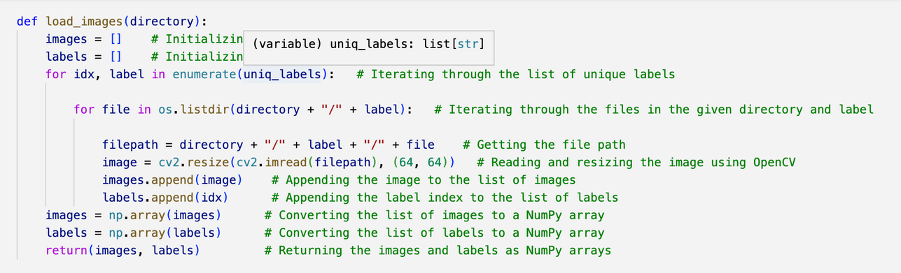
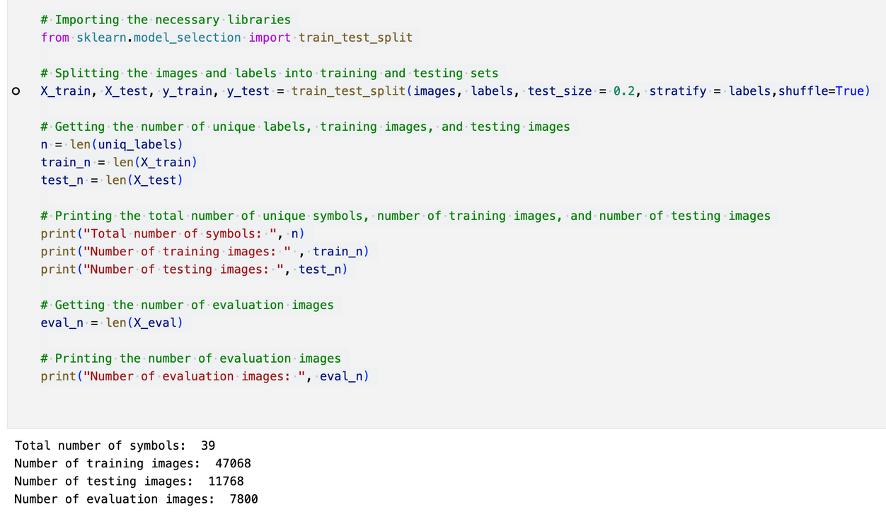
DATA PREPROCESSING PT. 1
Import necessary libraries and packages: Import required libraries such as Keras, TensorFlow, NumPy, OpenCV, and Matplotlib.
Define helper function to load images from given directories: Create a function to load images from given directories, resize them to 64x64 pixels using OpenCV, and store them as lists before converting them to NumPy arrays.
Split images and labels into training and testing sets: Use the train_test_split() function from scikit-learn to split the images and labels into training and testing sets with an 80-20 ratio.
Notes:
Import necessary libraries and packages: The required libraries and packages are imported, such as Keras, TensorFlow, NumPy, OpenCV, and Matplotlib.
Define helper function to load images from given directories: The function is created to load images from the given directories. It takes the directory path as an argument, iterates through the files in the directory, and resizes each image to 64x64 pixels using OpenCV. It then stores the images and labels in lists and converts them to NumPy arrays before returning them.
Load images and labels from training directory: The list of unique labels is obtained from the training directory using the os module. The .DS_Store file is removed from the list of labels if it exists. Then, the load_images() function is used to load the images and labels from the training directory.
Load images and labels from evaluation directory: The same process as step 3 is followed for the evaluation directory. The load_images() function is used to load the images and labels from the evaluation directory if the list of unique labels from the training and evaluation directory are the same.
Split images and labels into training and testing sets: The train_test_split() function from scikit-learn is used to split the images and labels into training and testing sets with a 80-20 ratio.

Slide 7
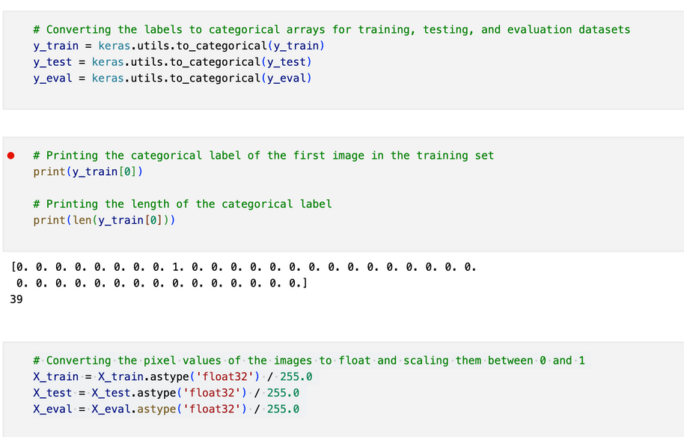
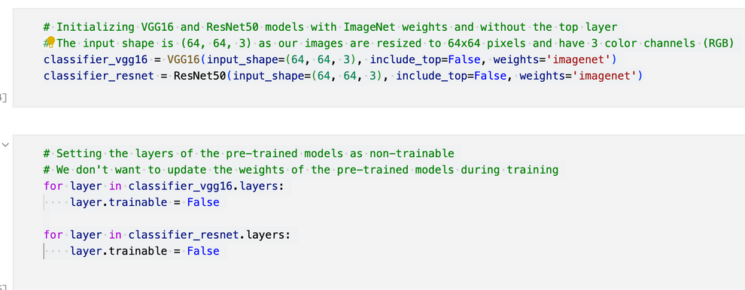
DATA PREPROCESSING PT. 2
Convert labels to categorical arrays using to_categorical() function from Keras.
Convert pixel values of images to float and scale them between 0 and 1 using X_train.astype('float32') / 255.0 formula.
Initialize VGG16 and ResNet50 models with ImageNet weights and without top layer using VGG16() and ResNet50() functions from Keras and TensorFlow.
Notes:
Convert labels to categorical arrays: The labels for training, testing, and evaluation datasets are converted to categorical arrays using the to_categorical() function from Keras.
Convert pixel values of images to float and scale them between 0 and 1: The pixel values of the images are converted to float and scaled between 0 and 1 using the formula X_train.astype('float32') / 255.0, where X_train is the training data.
Initialize VGG16 and ResNet50 models with ImageNet weights and without the top layer: The VGG16 and ResNet50 models are initialized with ImageNet weights and without the top layer using the VGG16() and ResNet50() functions from Keras and TensorFlow,

Slide 8
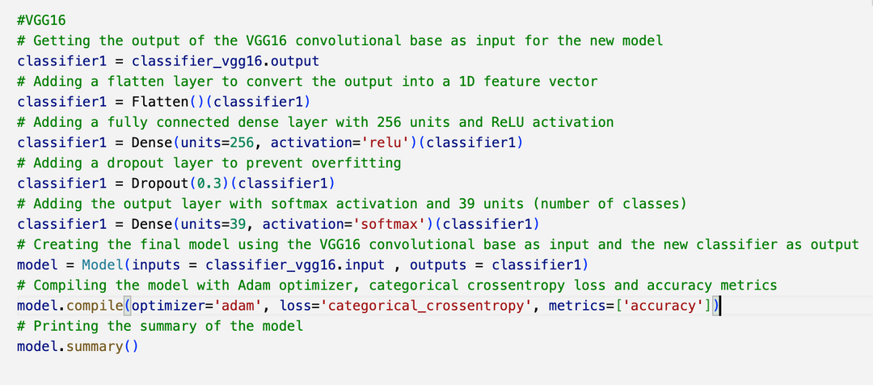
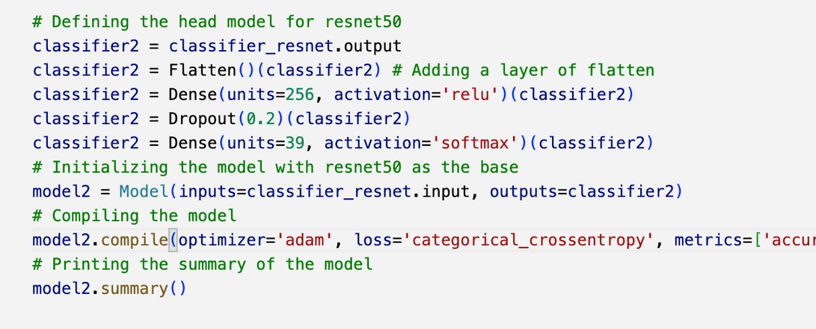
MODELLING
VGG16
Resnet50
Notes:
In this code, two deep learning models (VGG16 and ResNet50) are initialized and their convolutional bases are used as input to new classifiers.
These new classifiers consist of a flatten layer, a fully connected dense layer with ReLU activation, a dropout layer to prevent overfitting, and an output layer with softmax activation. The models are compiled with Adam optimizer, categorical cross-entropy loss, and accuracy metrics.

Slide 9
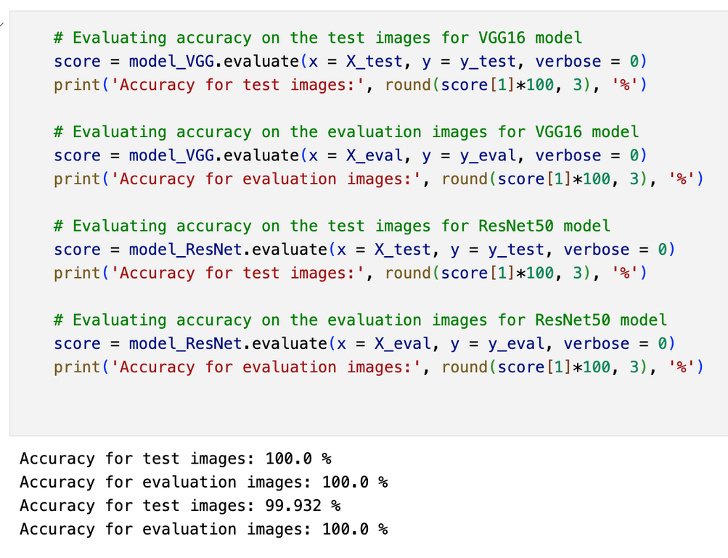
MODEL PERFORMANCE
Notes:
Accuracy is nearing 100% in case of both models,
While predicting we noticed that the predictions ain't always correct this could happen due to overfitting, where the model is too complex and has memorized the training data instead of learning the underlying patterns. Therefore, high accuracy does not necessarily mean that the model is always correct in its predictions on new data.

Slide 10
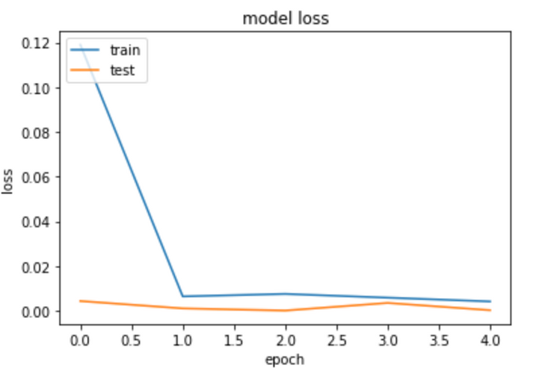
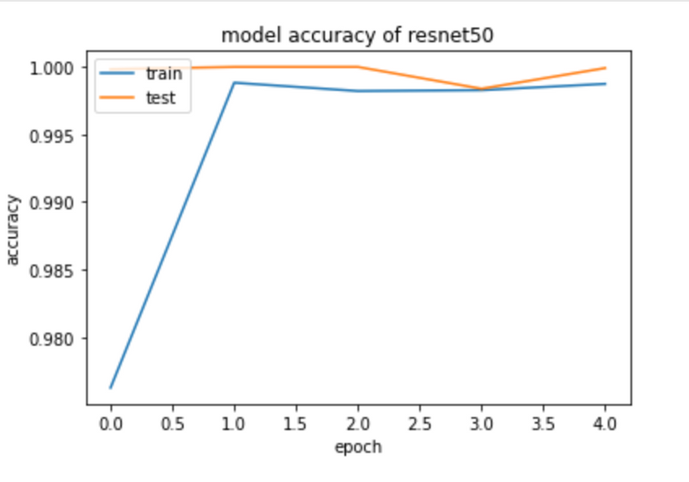
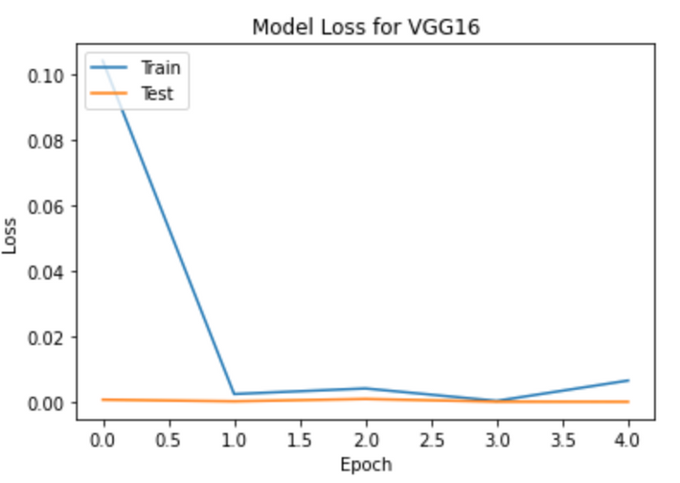
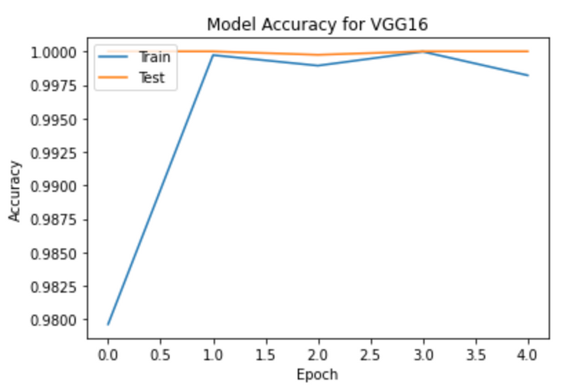
MODEL EVALUATION (VGG16)
Accuracy (test,train) vs epoch
model loss (test,train) vs epoch

Slide 11
MODEL EVALUATION (RESNET50)
Accuracy (test,train) vs epoch
model loss (test,train) vs epoch

Slide 12
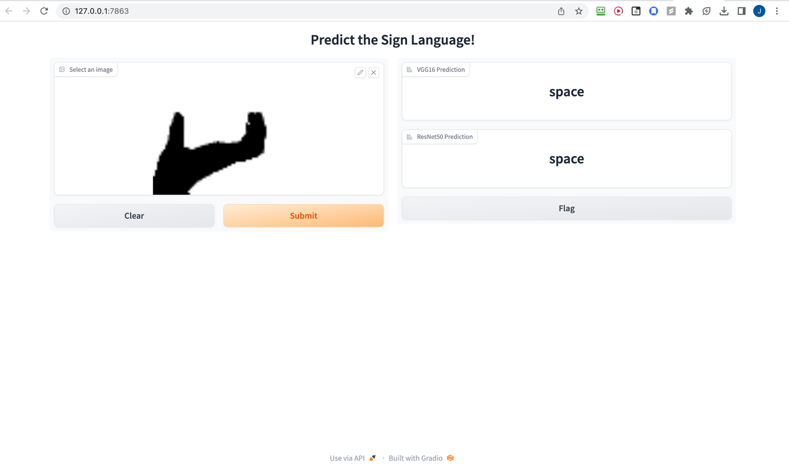
USER INTERFACE
Notes:
When a user uploads an image, the interface first preprocesses the image by reshaping it to a size of 64x64 pixels and then creates a 4D array from it. Then, the interface uses both the VGG16 and ResNet50 models to predict what the gesture in the image means.
The predicted gesture text results are shown on the web page in two separate boxes labeled "VGG16 Prediction" and "ResNet50 Prediction", respectively. The user can then view and compare the two predictions to see if they agree or not.

Slide 13

GROUP 8
THANK YOU
LET'S HEAD TO THE DEMO

